Slide 1

Co-op Progress Presentation
Yang Li, Department of Mechanical and Mechatronics Engineering
Photo credit: @bruce.digital

Slide 2

About Me
My name is Yang Li
Born in Windsor, Ontario, Canada
Going into 2B Mechatronics Engineering at UW this Fall

Slide 3

About Me
Lived in Indianapolis, Indiana for the last 4 months

Slide 4
Co-op Progress Timeline
Research PCB Piezotronics wired sensor setup and integration (May 18 – 31)
August
May
June
July
September
Integrate LabJack DAQ with wired sensors and CC circuit (June 19 – 30)
Organize and modify collected data (July 8 – 17)
?
Test capabilities of Erbessd Instruments Bluetooth sensors (May 15 – 17)
Collect data on 5 different machines at Perfecto (July 5 – 7)
Develop software and support programs for vibration collection and chatter detection (June 1 – 18)
Collect additional data from Hurco 5-Axis machine (August 4 – 17)

Slide 5
Co-op Progress Timeline
Research PCB Piezotronics wired sensor setup and integration (May 18 – 31)
August
May
June
July
September
Integrate LabJack DAQ with wired sensors and CC circuit (June 19 – 30)
Organize and modify collected data (July 8 – 17)
?
Test capabilities of Erbessd Instruments Bluetooth sensors (May 15 – 17)
Collect data on 5 different machines at Perfecto (July 5 – 7)
Develop software and support programs for vibration collection and chatter detection (June 1 – 18)
Collect additional data from Hurco 5-Axis machine (August 4 – 17)

Slide 6
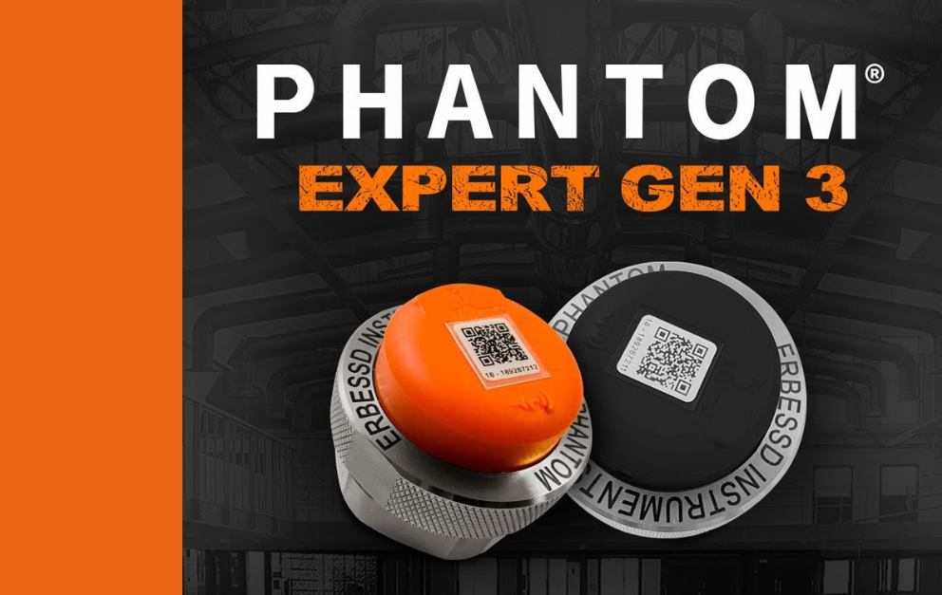
Erbessd Instruments (EBI) Bluetooth Sensor
Pros:
Bluetooth connection
Magnetic mounting included
Mobile app available
Cons:
Limited data collection period
Sampling frequency decreases as length of data collection period increases
Tech Specs:
Range: ± 8 G
Sampling Rate: 1600 Hz
Axes: Triaxial
Sensitivity: 100 mV/G

Slide 7
Erbessd Instruments (EBI) Bluetooth Sensor
Use:
Fast and easy setup for collecting data due to wire-free Bluetooth connection and mobile app integration
Sampling rate of collected data is 1600 Hz for 16 seconds of data, providing less accurate results when used with chatter detection algorithms
Had difficulty integrating EBI sensors with other aspects of our hardware/software setup, due to closed source and poorly maintained product software

Slide 8
Co-op Progress Timeline
Research PCB Piezotronics wired sensor setup and integration (May 18 – 31)
August
May
June
July
September
Integrate LabJack DAQ with wired sensors and CC circuit (June 19 – 30)
Organize and modify collected data (July 8 – 17)
?
Test capabilities of Erbessd Instruments Bluetooth sensors (May 15 – 17)
Collect data on 5 different machines at Perfecto (July 5 – 7)
Develop software and support programs for vibration collection and chatter detection (June 1 – 18)
Collect additional data from Hurco 5-Axis machine (August 4 – 17)

Slide 9
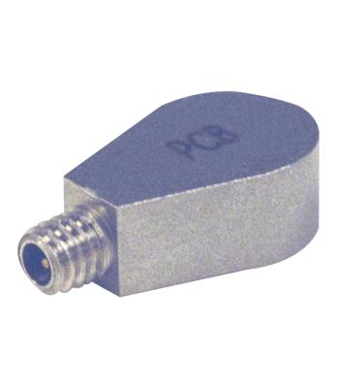
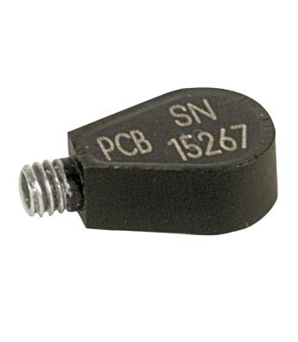
PCB Piezotronics (PCB) Wired Sensor
Pros:
Small sensor profile, the size of your pinky fingernail
Sourced from a well-known company and with industry-standard sensor characteristics
Data can be collected indefinitely, with no loss in sampling frequency
Open source, no restrictions on how sensor data can be integrated
Cons:
Wired setup is tedious, and cabling gets more damaged over time
Sensor comes with nothing else, or just the cable, so user must supply power to the sensor and find a way to record its data
Tech Specs:
Range: ± 500 G
Sampling Rate: 8000 Hz
Axes: Uniaxial
Sensitivity: 10 mV/G

Slide 10
PCB Piezotronics (PCB) Wired Sensor
Use:
After purchasing several additional items needed to create the constant current signal conditioner to power the sensors, they worked as advertised
Mounted black sensor along X axis spindle, silver sensor along Y axis of spindle, to take advantage of the higher resolution data
Continuously collected data was fed into chatter detection algorithms and yielded promising results

Slide 11
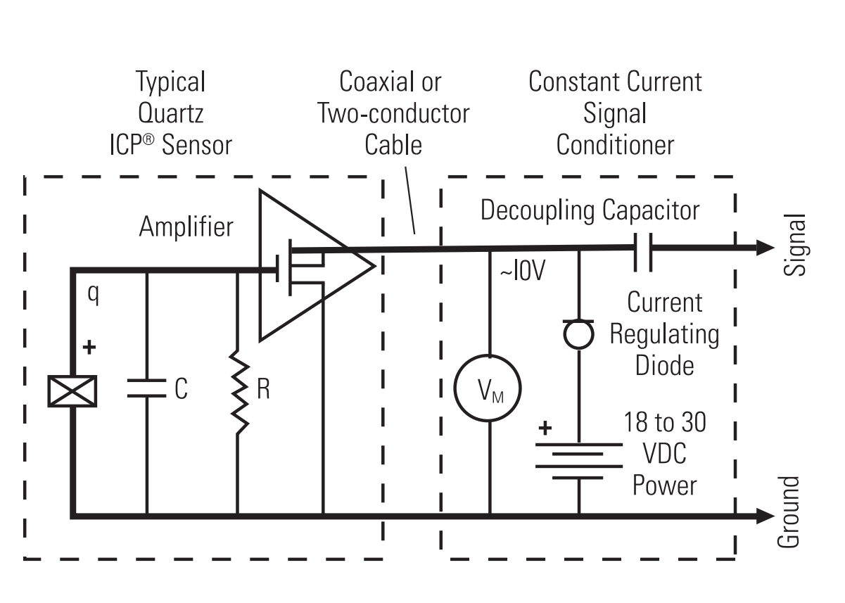
PCB Piezotronics (PCB) Wired Sensor

Slide 12
Co-op Progress Timeline
Research PCB Piezotronics wired sensor setup and integration (May 18 – 31)
August
May
June
July
September
Integrate LabJack DAQ with wired sensors and CC circuit (June 19 – 30)
Organize and modify collected data (July 8 – 17)
?
Test capabilities of Erbessd Instruments Bluetooth sensors (May 15 – 17)
Collect data on 5 different machines at Perfecto (July 5 – 7)
Develop software and support programs for vibration collection and chatter detection (June 1 – 18)
Collect additional data from Hurco 5-Axis machine (August 4 – 17)

Slide 13
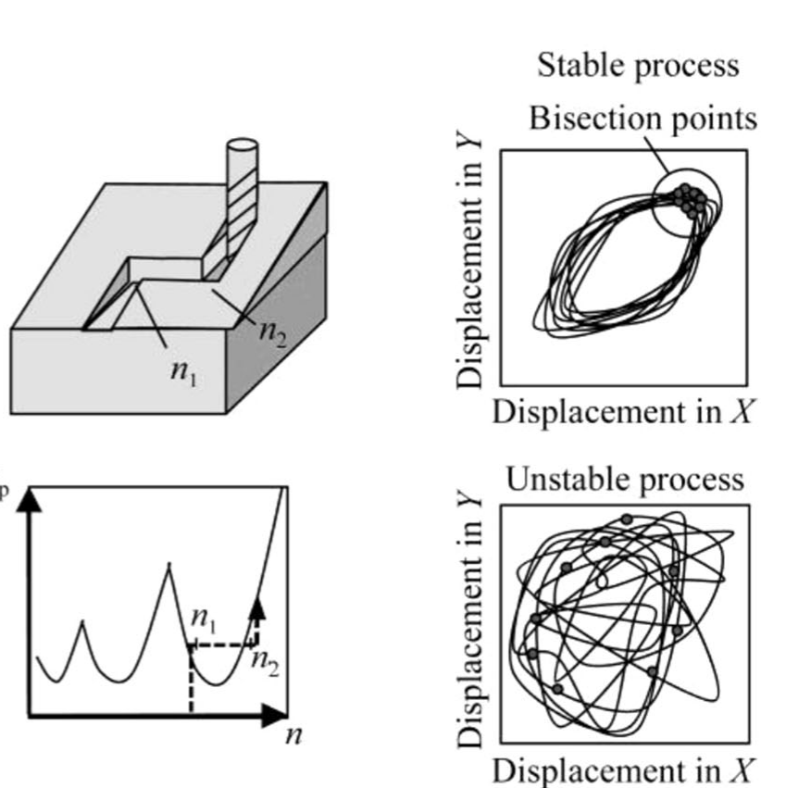
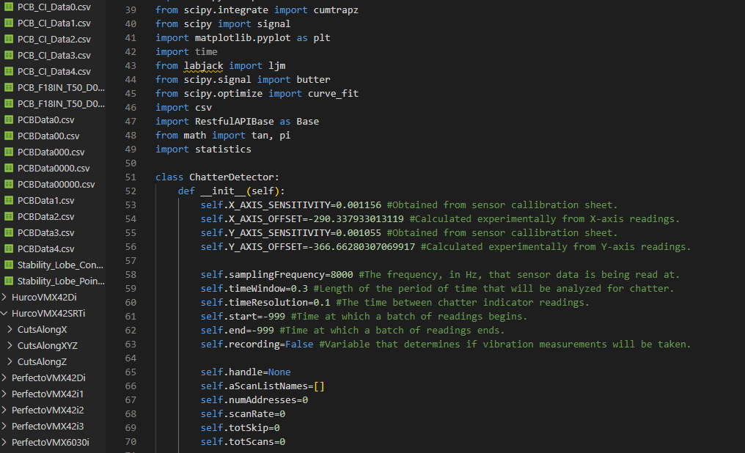
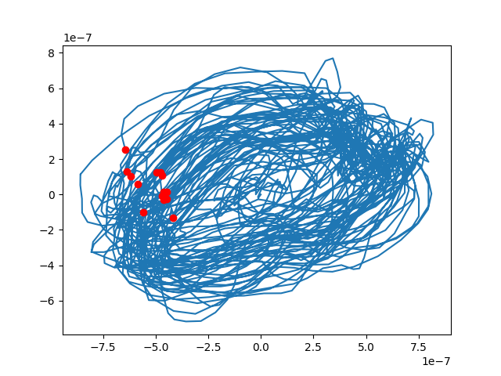
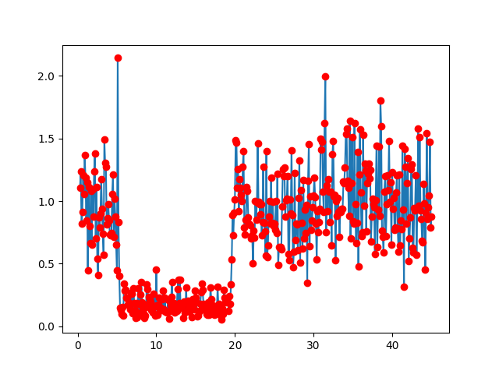
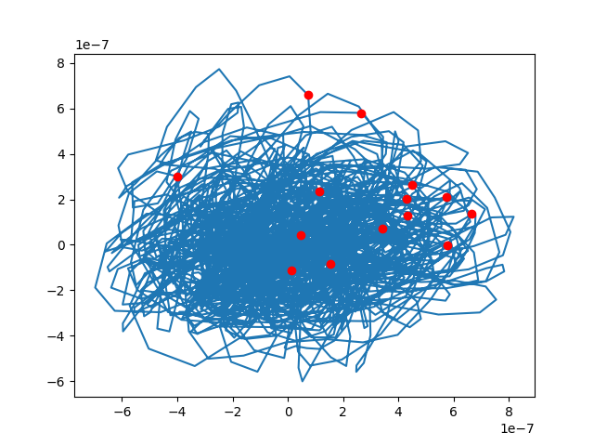
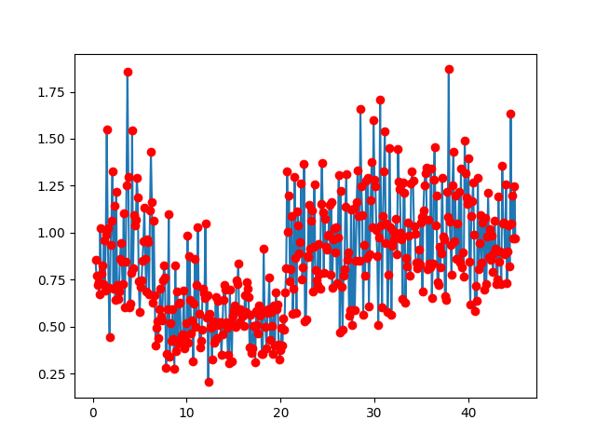
Vibration and Chatter Software
1. Research
2. Implement
3. Results
Read up on Efficient determination of stability lobe diagrams by in-process varying of spindle speed and cutting depth (Christian Brecher, 2018) and other supplementary material to gain an understanding of chatter behavior and causes.
Using a variety of Python packages designed for scientific and data analysis applications, implement the chatter indicator algorithm.
Generate plots of the Poincaré sections and the chatter indicator evolution.

Slide 14
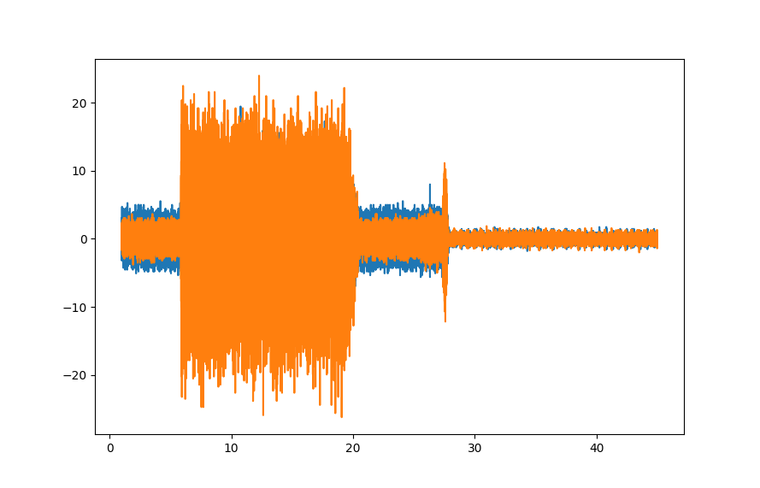
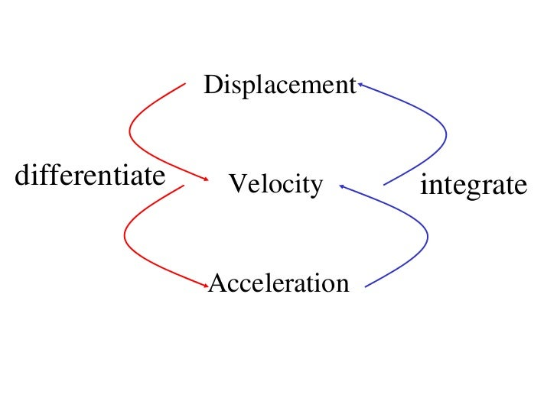
Vibration and Chatter Software
1. Filter
2. Integrate
3. Plot
Use empirically determined Butterworth filter settings to prepare data for algorithms.
Take filtered data, currently of acceleration in meters per second squared, and numerically integrate twice, going from acceleration to velocity, and velocity to displacement.
Generate plots of the Poincaré sections, which show the estimated trajectory of the spindle. By calculating the standard deviation of the data, calculate the chatter indicator and plot its evolution.

Slide 15
Co-op Progress Timeline
Research PCB Piezotronics wired sensor setup and integration (May 18 – 31)
August
May
June
July
September
Integrate LabJack DAQ with wired sensors and CC circuit (June 19 – 30)
Organize and modify collected data (July 8 – 17)
?
Test capabilities of Erbessd Instruments Bluetooth sensors (May 15 – 17)
Collect data on 5 different machines at Perfecto (July 5 – 7)
Develop software and support programs for vibration collection and chatter detection (June 1 – 18)
Collect additional data from Hurco 5-Axis machine (August 4 – 17)

Slide 16
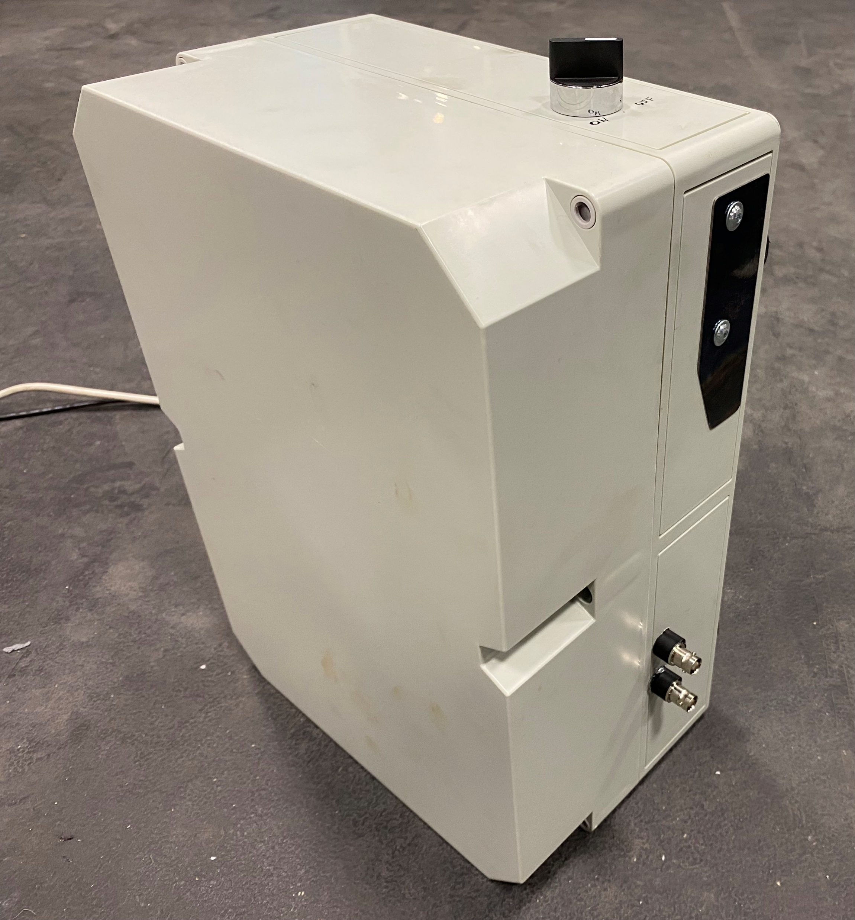
Vibration Measurement System

Slide 17
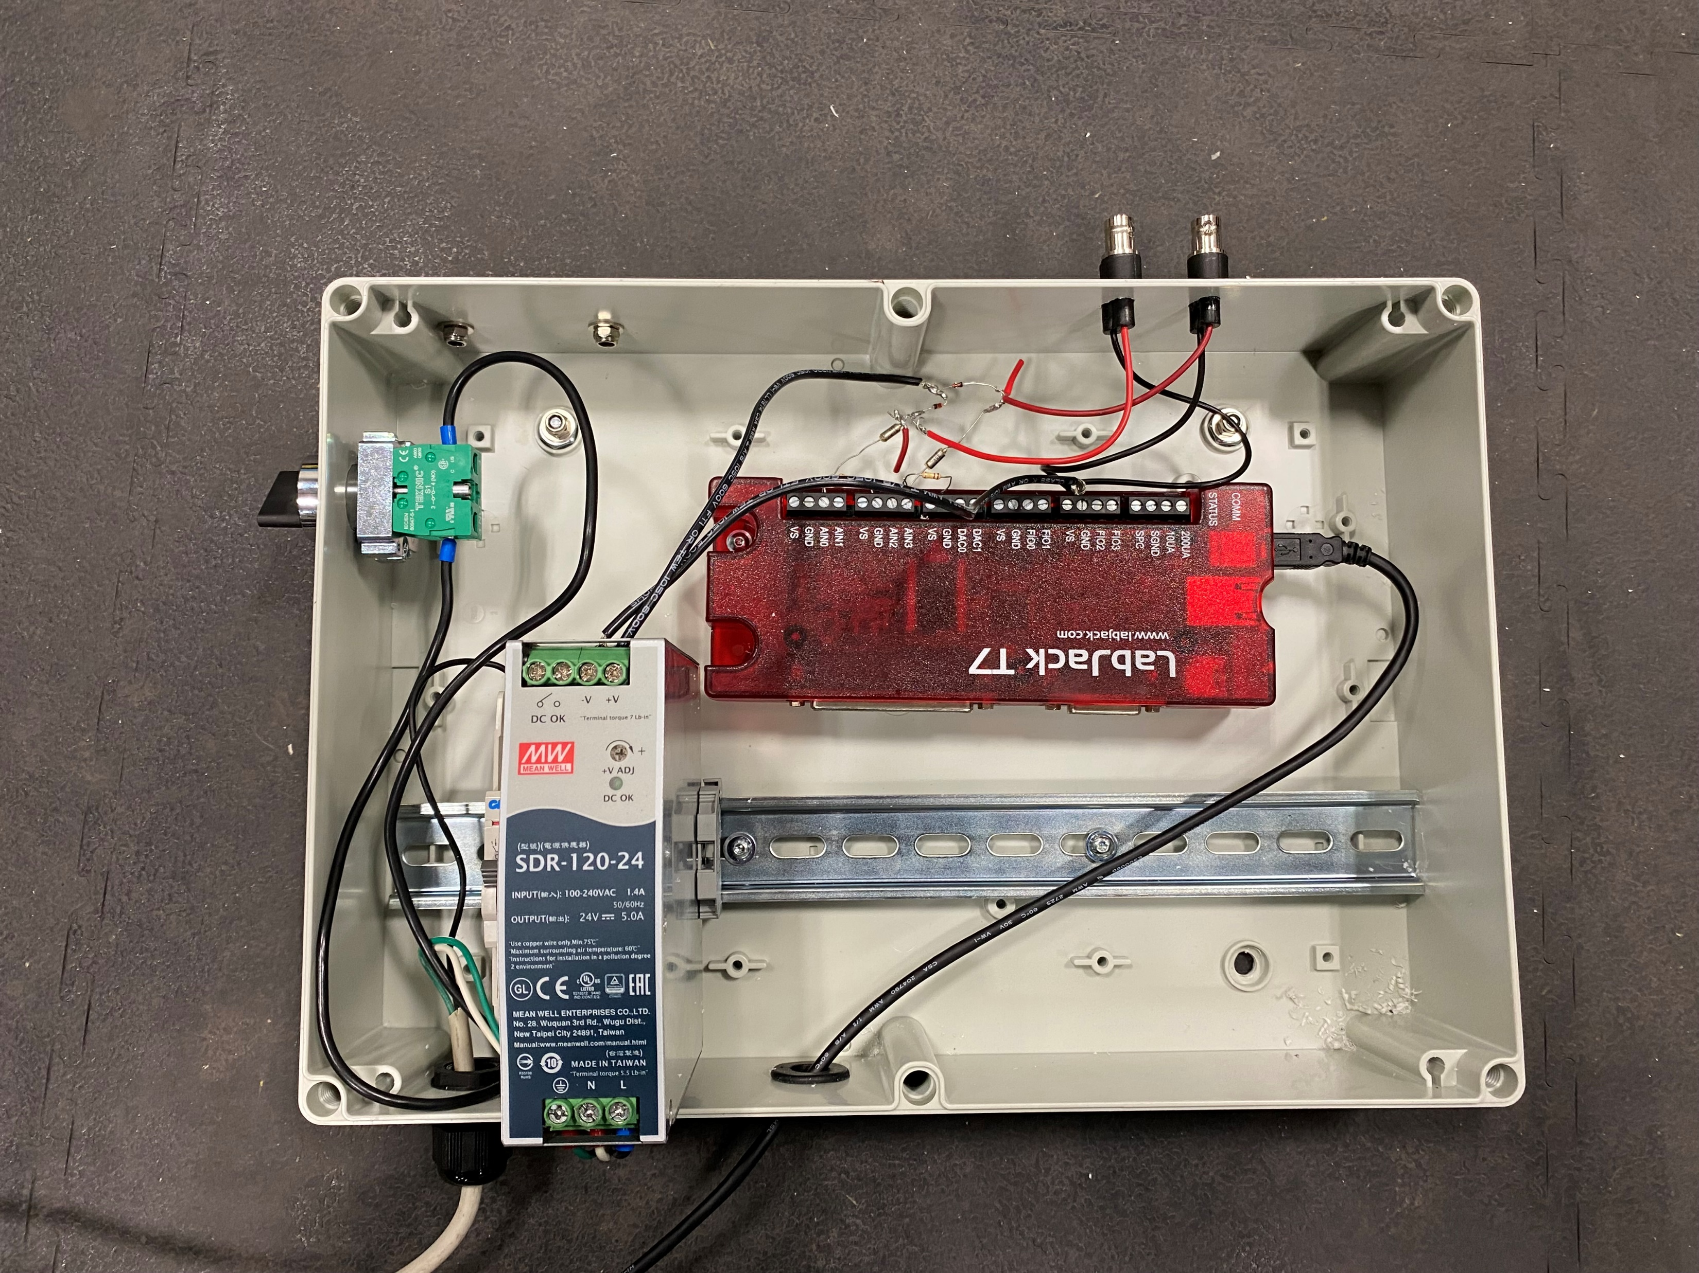
Vibration Measurement System

Slide 18
Co-op Progress Timeline
Research PCB Piezotronics wired sensor setup and integration (May 18 – 31)
August
May
June
July
September
Integrate LabJack DAQ with wired sensors and CC circuit (June 19 – 30)
Organize and modify collected data (July 8 – 17)
?
Test capabilities of Erbessd Instruments Bluetooth sensors (May 15 – 17)
Collect data on 5 different machines at Perfecto (July 5 – 7)
Develop software and support programs for vibration collection and chatter detection (June 1 – 18)
Collect additional data from Hurco 5-Axis machine (August 4 – 17)

Slide 19
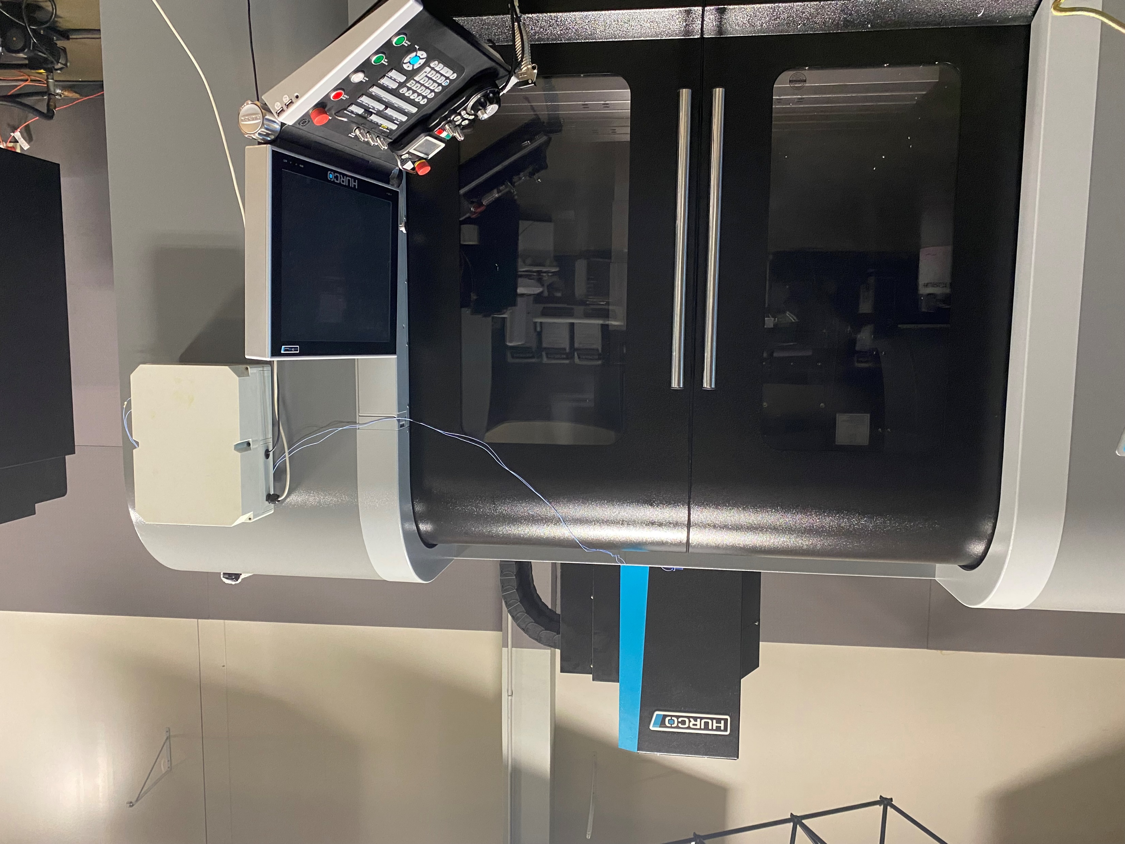
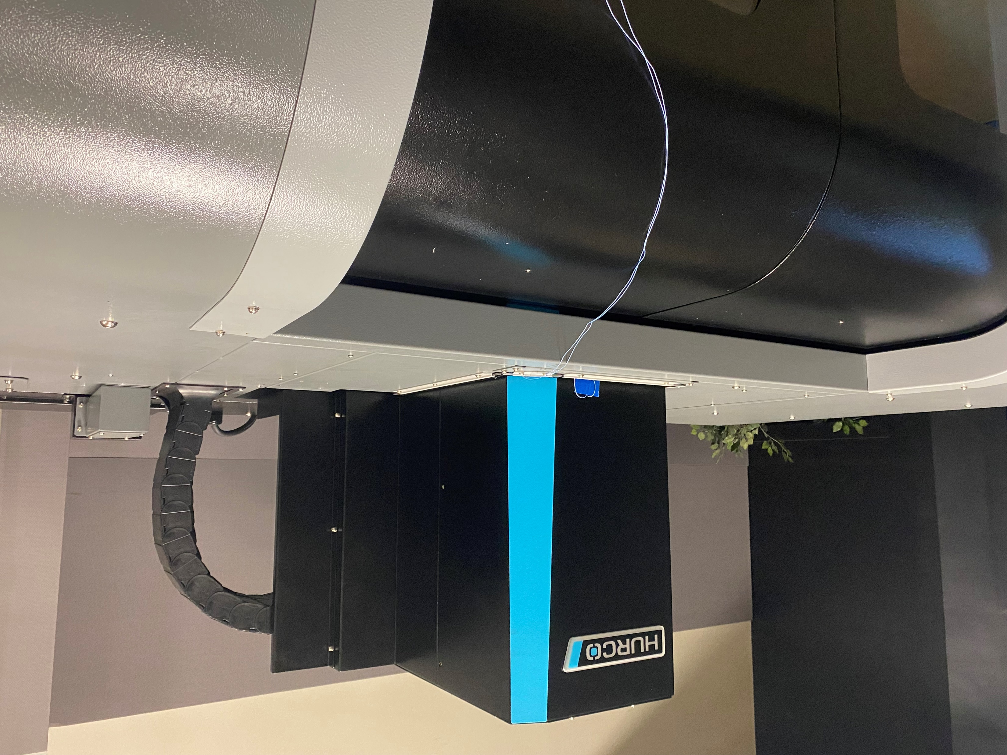
Data Collection Setup
Magnets attached on the back of the control box allow it to be easily mounted to the upper half of a machine’s exterior
Sensor cabling is threaded through gaps in the roof of machines

Slide 20
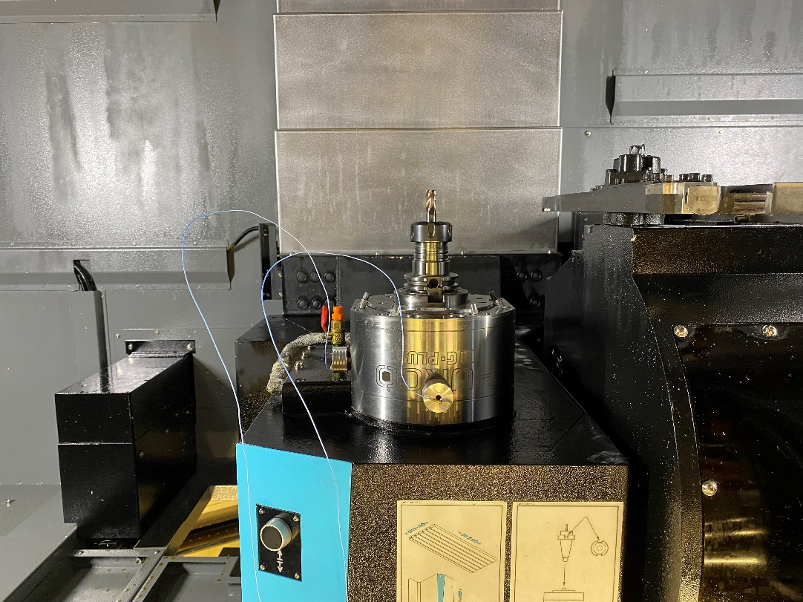
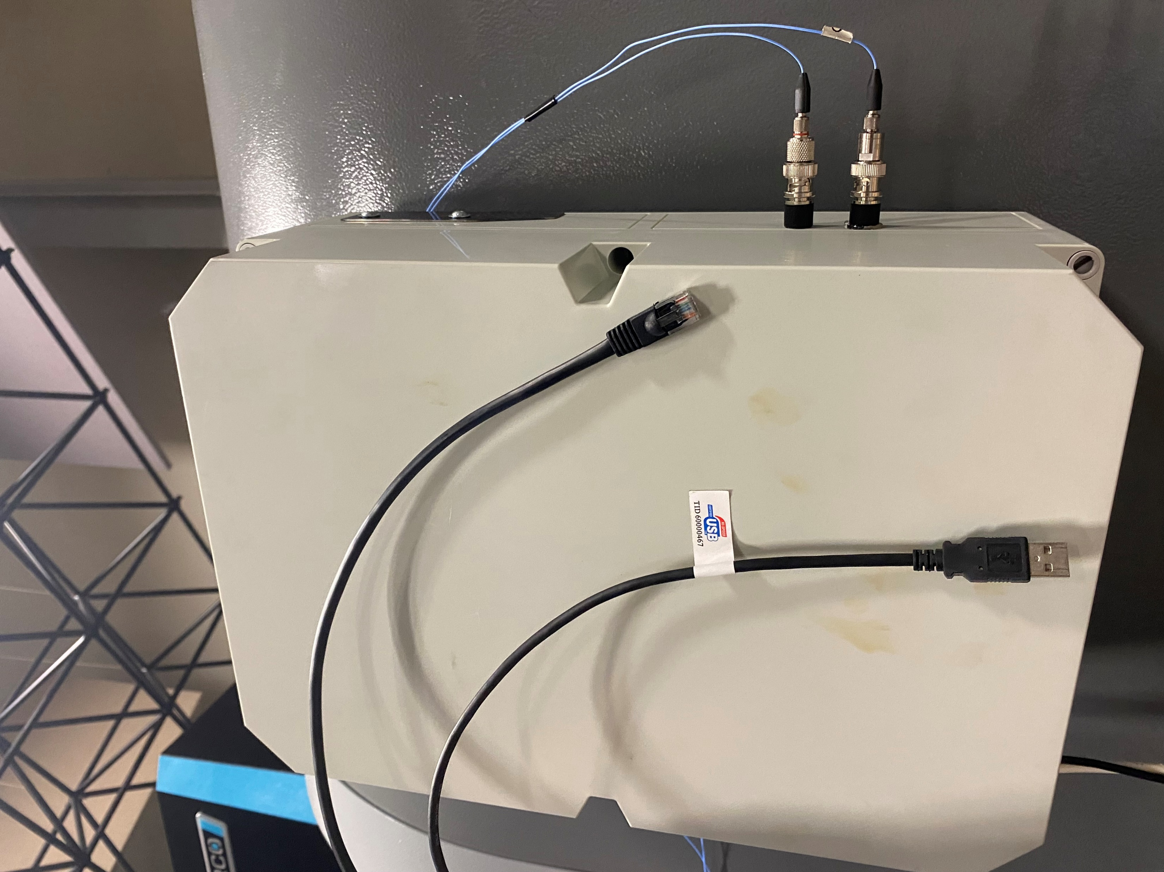
Data Collection Setup
Sensors are attached to magnetic mounts via superglue, then stuck onto the X and Y axes of machine spindles
Processing laptop is connected to machine via ethernet to record values from machine REST API, and is connected to control box via USB to collect data in real time

Slide 21
Co-op Progress Timeline
Research PCB Piezotronics wired sensor setup and integration (May 18 – 31)
August
May
June
July
September
Integrate LabJack DAQ with wired sensors and CC circuit (June 19 – 30)
Organize and modify collected data (July 8 – 17)
?
Test capabilities of Erbessd Instruments Bluetooth sensors (May 15 – 17)
Collect data on 5 different machines at Perfecto (July 5 – 7)
Develop software and support programs for vibration collection and chatter detection (June 1 – 18)
Collect additional data from Hurco 5-Axis machine (August 4 – 17)

Slide 22
Co-op Progress Timeline
Research PCB Piezotronics wired sensor setup and integration (May 18 – 31)
August
May
June
July
September
Integrate LabJack DAQ with wired sensors and CC circuit (June 19 – 30)
Organize and modify collected data (July 8 – 17)
?
Test capabilities of Erbessd Instruments Bluetooth sensors (May 15 – 17)
Collect data on 5 different machines at Perfecto (July 5 – 7)
Develop software and support programs for vibration collection and chatter detection (June 1 – 18)
Collect additional data from Hurco 5-Axis machine (August 4 – 17)

Slide 23
Thanks!

